Slide 1
Efficient and Privacy-Preserving Decision Tree Classification for Health Monitoring Systems
We are working on this project
Under the guidance of
Mrs. K . Rampriya
(Asst. prof)
Department of CSE(AI&ML) Presented by
G.HARIKA
K.ROHITH
R.SHREYA
SANA TABASSUM
-20R01A66D9
- 20R01A66E5
- 20R01A66G4
- 20R01A66G7

Slide 2
INDEX
ABSTRACT
INTRODUCTION OBJECTIVE OF THE PROJECT LITERATURE REVIEW/LITERATURE SURVEY EXISTING SYSTEM LIMITATIONS OF EXISTING SYSTEM PROPOSED SYSTEM ADVANTAGES OF PROPOSED SYSTEM ALGORITHMS USED SYSTEM ARCHITECTURE CLASS DIAGRAM DATA FLOW DIAGRAM FLOWCHART DIAGRAM

Slide 3
ABSTRACT
Due to the increasing healthcare costs and the advance of wireless technology, health monitoring systems have been widely adopted recently. In health monitoring systems, a hospital outsources a clinical decision model to a cloud service provider, which receives biomedical data from remote clients and produces clinical decisions based on the outsourced model. Due to critical privacy concerns, both the clinical decision model and biomedical data should be protected. In this article, we propose an efficient and privacy-preserving decision tree (PPDT) classification scheme for health monitoring systems. Specifically, we first transform a decision tree classifier (i.e., the clinical decision model) into the Boolean vectors. Then, we leverage symmetric key encryption to encrypt the Boolean vectors as encrypted indices. The PPDT classification is achieved by searching the encrypted indices with encrypted tokens. We formulate a leakage function and provide the security definition and simulation-based proof for PPDT. The performance analyses demonstrate that PPDT is very efficient in terms of computation, communication, and storage. Experimental evaluations show that PPDT only requires microsecond-level execution time, kilobyte-level communication costs, and kilobyte-level storage costs on the test data set.

Slide 4
INTRODUCTION
With the growing cases of Chronic Diseases, more and more patients have to test their Health Conditions constantly at hospitals, which leads to skyrocketing costs for healthcare systems. To reduce the healthcare costs and improve the healthcare quality, health monitoring systems, which are often built by utilizing decision tree classification, help patients to test their health conditions periodically. Coupled with recent advances of wearable devices and mobile communication networks, health monitoring systems work as follows: a hospital first utilizes decision tree classification technique to produce a clinical decision model, and later tests clients’ biomedical data collected from wearable devices and provides decisions for clients based on the model . To further reduce the costs on the hospital side and enable practical deployment, the hospital often outsources the health monitoring services to a cloud server, which brings prominent
benefits for both clients and the hospital, such as ubiquitous access, ease of management, and scalability. Despite the well-known benefits, outsourcing health monitoring services to a semi-trusted cloud also arises critical privacy concerns.
On the hospital side, since the hospital may invest a large number of resources to gather sensitive biomedical dataset and train the clinical decision model, the model is valuable intellectual property, which brings commercial benefits to the hospital. Thus, there is a demand for the hospital to protect the content of clinical decision model when outsourcing health monitoring services to the cloud service provider. On the clients’ side, both the physiological features and the clinical decision are sensitive biomedical data, because accidental leakage of either information may reflect the clients’
health condition and lead to serious issues. For instance, if a client has a certain chronic disease, the exposure of health
condition deterioration may increase the health insurance costs to the client. With the aforementioned privacy concerns, both the clinical decision model and the biomedical data should be concealed from the cloud service provider in health monitoring systems.
Efficient and Privacy-Preserving Decision Tree Classification for Health Monitoring Systems
4

Slide 5
OBJECTIVE OF THE PROJECT
The objective of implementing Efficient and Privacy-Preserving Decision Tree Classification for Health Monitoring Systems is to strike a balance between accuracy in health predictions and safeguarding the privacy of sensitive health data. The project aims to achieve the following key goals:
Improved Predictive Accuracy:
Enhance the accuracy of health monitoring predictions by employing efficient decision tree classification algorithms.
Investigate and implement techniques that contribute to higher precision and recall in health-related predictions.
Privacy Preservation:
Implement robust privacy-preserving mechanisms to ensure that sensitive health data remains confidential and secure.
Explore methods such as homomorphic encryption, secure multi-party computation, or differential privacy to protect individual privacy during the decision tree classification process.
Efficiency Optimization:
Optimize the decision tree classification process to be computationally efficient, especially in resource-constrained environments such as wearable devices or remote health monitoring systems.
Explore techniques like model compression, feature selection, or pruning to reduce the computational burden while maintaining prediction accuracy.
Dynamic Adaptability:
Design the system to adapt to changes in health conditions over time.
Implement mechanisms for continuous learning and updating of the decision tree model based on new data, ensuring the system's relevance and adaptability.
User Trust and Acceptance:
Develop a user-friendly interface that fosters trust among healthcare professionals and end-users.
Prioritize transparency in the decision-making process to make the predictions more interpretable and acceptable to users.
Regulatory Compliance:
Ensure that the implementation adheres to relevant healthcare data protection regulations and standards, such as HIPAA or GDPR.
Implement robust security measures to safeguard health data and ensure compliance with legal and ethical standards.
Cross-Device Compatibility:
Enable seamless integration with various health monitoring devices, ensuring interoperability and accessibility across a range of platforms.
Validation and Evaluation:
Conduct thorough validation and evaluation of the system's performance, comparing it against traditional decision tree models and assessing the impact of privacy-preserving techniques on predictive accuracy.

Slide 6
LITERATURE SURVEY / LITERATURE REVIEW

Slide 7
EXISTING SYSTEM
HE-based schemes. Most of the HE-based schemes consider a hospital-client setting for health monitoring systems. In this setting, the hospital’s clinical decision tree model is required to be protected from the client, while the client’s biomedical features and clinical predictions are required to be protected from the hospital. HE-based schemes protect the privacy of clinical model and biomedical data by utilizing FHE or AHE. Although HE-based schemes enable privacy-preserving decision tree classification for health monitoring systems, these schemes may face high computational costs due to high-complexity homomorphic operations.
To achieve efficient health monitoring services, it is desirable to design a scheme with low computation costs. Namely, achieving sub-linear computational complexity and avoiding cryptographic tools with expensive computational
costs.
MPC-based schemes. Considering a system model with multiple non-colluding hospitals or multiple non-colluding clients, most of the MPC-based schemes evaluate the prediction interactively and collaboratively.

Slide 8
MPC-based schemes protect the privacy of both clinical decision model and biomedical data by utilizing tailored GC ,SS or hybrid cryptographic tools that combine OT, SS, GC, and
AHE Although MPC-based schemes avoid using high-complexity encryption, these schemes are designed based on a multiple party non-collusion security assumption and incur prohibitive communication costs due to collaboratively evaluation. To achieve real-time health monitoring services, it is important to design a novel scheme with low communication costs, i.e., avoiding MPC techniques.
SSE-based schemes. To improve the computational and communication efficiency for health monitoring systems, Liang et al. consider a system model that involves a hospital, a client, and a cloud service provider. In this setting, the hospital outsources the clinical decision model to a cloud service provider, and thus the clinical decision model and biomedical data should be protected against the cloud service provider [20]. Liang et al. extract decision rules from decision tree classifiers, and develop an SSE-based scheme (SDTC) with O(1) computational complexity and 1 round communication interaction [20]. Yet, since the size of indexes in SDTC are exponential to the size of the decision tree classifier, SDTC suffers from prohibitive storage overheads. Furthermore, the large size of indexes increase both the computational cost and the communication cost of SDTC. To achieve practical health monitoring services, it is important to design a scheme with low storage costs. Namely, the storage cost should not be exponential to the size of the input domain.

Slide 9
Limitations of Existing System
To protect the confidentiality of both clinical decision models and biomedical data, several privacy-preserving decision tree classification schemes.
MPC-based schemes enable multiple parties jointly and privately classify data according to decision trees, but they may lead to expensive communication costs.

Slide 10
Proposed System
We propose an efficient and privacy-preserving decision tree classification scheme (PPDT) for health monitoring systems. First, we transform decision tree classifiers to boolean vectors, which are indexes that enable O(1) computational complexity for decision tree classification.
With such boolean vectors, PPDT significantly improves computation, communication, and storage efficiency simultaneously. By utilizing symmetric key encryption, pseudo-random functions, and pseudo-random permutations to protect the confidentiality of clinical decision models and biomedical data, PPDT significantly reduces the computational costs due to the adoption of low complexity cryptographic primitives.
We formulate a security definition and give a simulation based security proof for PPDT. First, we identify a leakage function L, which includes the size pattern, search pattern, and access pattern of PPDT. Then, we formulate the L-security definition, which is defined based on the leakage function L. Finally, we provide a simulation-based security proof to demonstrate that PPDT captures the L-security definition. Namely, both the clinical decision model and biomedical data are well protected.

Slide 11
We conduct performance analyses and evaluations for PPDT. We analyze the computational costs and index sizes of PPDT and the scheme in (SDTC). Despite both PPDT and SDTC are with O(1) computational complexity, the comparison results show that PPDT requires lower computational costs and smaller index sizes than SDTC. The experimental evaluations in Breast-Cancer-Wisconsin dataset also illustrate the performance advantages of PPDT. The performance evaluations demonstrate that: (1) the computational complexity of PPDT is O(1), (2) PPDT only requires micro seconds level execution time, kilobyte-level communication costs, and kilobyte-level storage costs for achieving privacy preserving decision tree classification, and (3) The performance (including computation, communication, and storage efficiency) of PPDT is orders of magnitudes boosted than SDTC.

Slide 12
Advantages of Proposed System
DATA CONFIDENTIALITY:- Since biomedical features and clinical decisions are sensitive data for C,
the confidentiality of biomedical data should keep secret against CSP.
MODEL CONFIDENTIALITY:- Due to intellectual property protection issues, the clinical decision model is valuable
knowledge assets for H. Thus, the confidentiality of clinical decision model should
be protected against CSP.

Slide 13
Algorithms Used
SUPPORT VECTOR MACHINE
LOGISTIC REGRESSION
DECISION TREE CLASSIFIER
SGD CLASSIFIER
NAÏVE BAYES
K NEIGHBORS CLASSIFIER

Slide 14
SUPPORT VECTOR MACHINE
In classification tasks a discriminant machine learning technique aims at finding, based on an independent and identically distributed (iid) training dataset, a discriminant function that can correctly predict labels for newly acquired instances. Unlike generative machine learning approaches, which require computations of conditional probability distributions, a discriminant classification function takes a data point x and assigns it to one of the different classes that are a part of the classification task. Less powerful than generative approaches, which are mostly used when prediction involves outlier detection, discriminant approaches require fewer computational resources and less training data, especially for a multidimensional feature space and when only posterior probabilities are needed. From a geometric perspective, learning a classifier is equivalent to finding the equation for a multidimensional surface that best separates the different classes in the feature space.
SVM is a discriminant technique, and, because it solves the convex optimization problem analytically, it always returns the same optimal hyperplane parameter in contrast to genetic algorithms (GAs) or perceptrons, both of which are widely used for classification in machine learning. For perceptrons, solutions are highly dependent on the initialization and termination criteria. For a specific kernel that transforms the data from the input space to the feature space, training returns uniquely defined SVM model parameters for a given training set, whereas the perceptron and GA classifier models are different each time training is initialized. The aim of Gas and perceptrons is only to minimize error during training, which will translate into several hyperplanes’ meeting this requirement.

Slide 15
Logistic Regression
Logistic regression analysis studies the association between a categorical dependent variable and a set of independent (explanatory) variables. The name logistic regression is used when the dependent variable has only two values, such as 0 and 1 or Yes and No. The name multinomial logistic regression is usually reserved for the case when the dependent variable has three or more unique values, such as Married, Single, Divorced, or Widowed. Although the type of data used for the dependent variable is different from that of multiple regression, the practical use of the procedure is similar.
Logistic regression competes with discriminant analysis as a method for analyzing categorical-response variables. Many statisticians feel that logistic regression is more versatile and better suited for modeling most situations than is discriminant analysis. This is because logistic regression does not assume that the independent variables are normally distributed, as discriminant analysis does.
This program computes binary logistic regression and multinomial logistic regression on both numeric and categorical independent variables. It reports on the regression equation as well as the goodness of fit, odds ratios, confidence limits, likelihood, and deviance. It performs a comprehensive residual analysis including diagnostic residual reports and plots. It can perform an independent variable subset selection search, looking for the best regression model with the fewest independent variables. It provides confidence intervals on predicted values and provides ROC curves to help determine the best cutoff point for classification. It allows you to validate your results by automatically classifying rows that are not used during the analysis.

Slide 16
Decision Tree Classifier
Decision tree classifiers are used successfully in many diverse areas. Their most important feature is the capability of capturing descriptive decision making knowledge from the supplied data. Decision tree can be generated from training sets. The procedure for such generation based on the set of objects (S), each belonging to one of the classes C1, C2, …, Ck is as follows:
Step 1:- If all the objects in S belong to the same class, for example Ci, the decision tree for S consists of a leaf labeled with this class
Step 2:- Otherwise, let T be some test with possible outcomes O1, O2,…, On. Each object in S has one outcome for T so the test partitions S into subsets S1, S2,… Sn where each object in Si has outcome Oi for T. T becomes the root of the decision tree and for each outcome Oi we build a subsidiary decision tree by invoking the same procedure recursively on the set Si.

Slide 17
SGD CLASSIFIER
Stochastic Gradient Descent (SGD) is a simple yet very efficient approach to fitting linear classifiers and regressors under convex loss functions such as (linear) Support Vector Machine and Logistic Regression. Even though SGD has been around in the machine learning community for a long time, it has received a considerable amount of attention just recently in the context of large-scale learning.
SGD has been successfully applied to large-scale and sparse machine learning problems often encountered in text classification and natural language processing. Given that the data is sparse, the classifiers in this module easily scale to problems with more than 10^5 training examples and more than 10^5 features.
Strictly speaking, SGD is merely an optimization technique and does not correspond to a specific family of machine learning models. It is only a way to train a model. Often, an instance of SGD Classifier or SGD Regressor will have an equivalent estimator in the scikit-learn API, potentially using a different optimization technique.

Slide 18
Naïve Bayes
The naive bayes approach is a supervised learning method which is based on a simplistic hypothesis: it assumes that the presence (or absence) of a particular feature of a class is unrelated to the presence (or absence) of any other feature Yet, despite this, it appears robust and efficient. Its performance is comparable to other supervised learning techniques. Various reasons have been advanced in the literature. In this tutorial, we highlight an explanation based on the representation bias. The naive bayes classifier is a linear classifier, as well as linear discriminant analysis, logistic regression or linear SVM (support vector machine). The difference lies on the method of estimating the parameters of the classifier (the learning bias).
While the Naive Bayes classifier is widely used in the research world, it is not widespread among practitioners which want to obtain usable results. On the one hand, the researchers found especially it is very easy to program and implement it, its parameters are easy to estimate, learning is very fast even on very large databases, its accuracy is reasonably good in comparison to the other approaches. On the other hand, the final users do not obtain a model easy to interpret and deploy, they does not understand the interest of such a technique.
Thus, we introduce in a new presentation of the results of the learning process. The classifier is easier to understand, and its deployment is also made easier. In the first part of this tutorial, we present some theoretical aspects of the naive bayes classifier. Then, we implement the approach on a dataset with Tanagra. We compare the obtained results (the parameters of the model) to those obtained with other linear approaches such as the logistic regression, the linear discriminant analysis and the linear SVM. We note that the results are highly consistent. This largely explains the good performance of the method in comparison to others. In the second part, we use various tools on the same dataset (Weka 3.6.0, R 2.9.2, Knime 2.1.1, Orange 2.0b and RapidMiner 4.6.0). We try above all to understand the obtained results.

Slide 19
K Nearest Neighbors
Simple, but a very powerful classification algorithm
Classifies based on a similarity measure
Non-parametric
Lazy learning
Does not “learn” until the test example is given
Whenever we have a new data to classify, we find its K-nearest neighbors from the training data

Slide 20
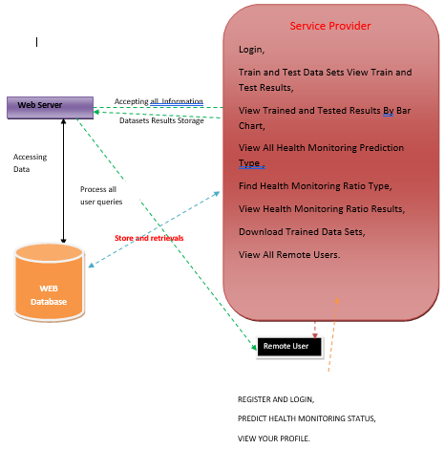
System Architecture

Slide 21
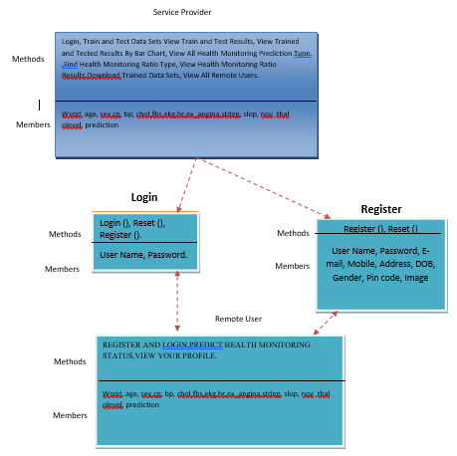
Class Diagram

Slide 22
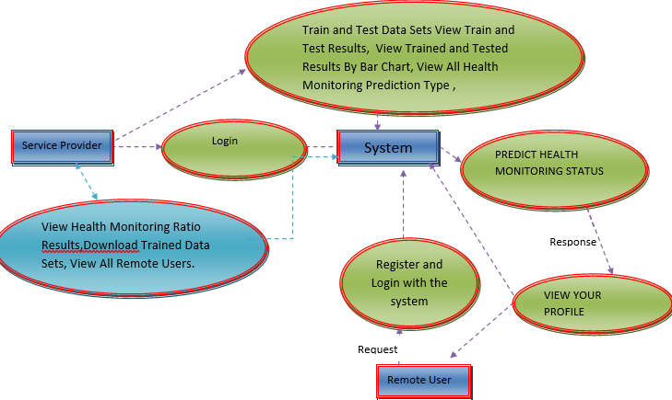
Data Flow Diagram

Slide 23
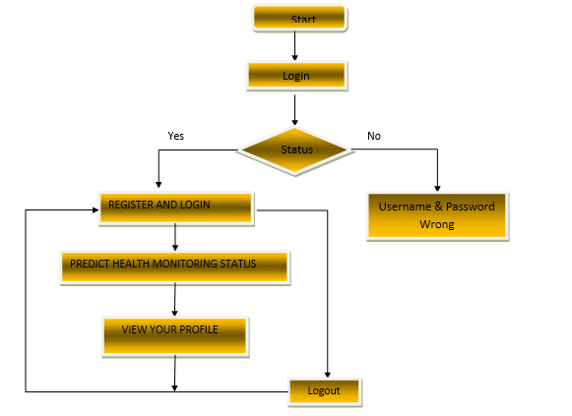
Flowchart Diagram

Slide 24
Thank you

